Slide 1
GLOWBOWL

Slide 2
Mission Statement
Foodservice Classification
Staffing
Menu
Target Population/Market Analysis
Location
Competitors
Budget

Slide 3
Mission Statement:
To make fresh food fast, by providing
individually prepared plant-based meals, based on wholesome and locally sourced ingredients, for
all diets
and lifestyles.

Slide 4
Food Service Classification
In 2011, it was estimated that Americans eat out about 200 meals per year outside the home. About 75% of these are from fast-casual outlets, QSRs”…(Hudson, pg.6).
Self-operated Commercial Foodservice - Quick Service Restaurant “foodservice organization that provides fast meals, which may Be eaten on the premise or are carried out” (Hudson, pg. 6).
Cook-Serve – All prepared and served on-site
Let’s make “FRESH FOOD FAST”!
Notes:
Why? A flexible menu, work with local ingredient sources
Why Cook-Serve? Fresh and quick

Slide 5
Staff Required
Chef
Front-line manager
Prep chef
Restaurant cashier
NOTE: All workers are required to pass ServSafe Allergens Online Course
https://www.servsafe.com/ServSafe-Allergens

Slide 6
MENU
Breakfast and lunch/dinner will be a mixture of a static and single use menu.
Basic ingredients are Static
ex: potatoes, rice, acai…
Locally Sourced Ingredients are Single Use
ex: fresh strawberries, avocado

Slide 7
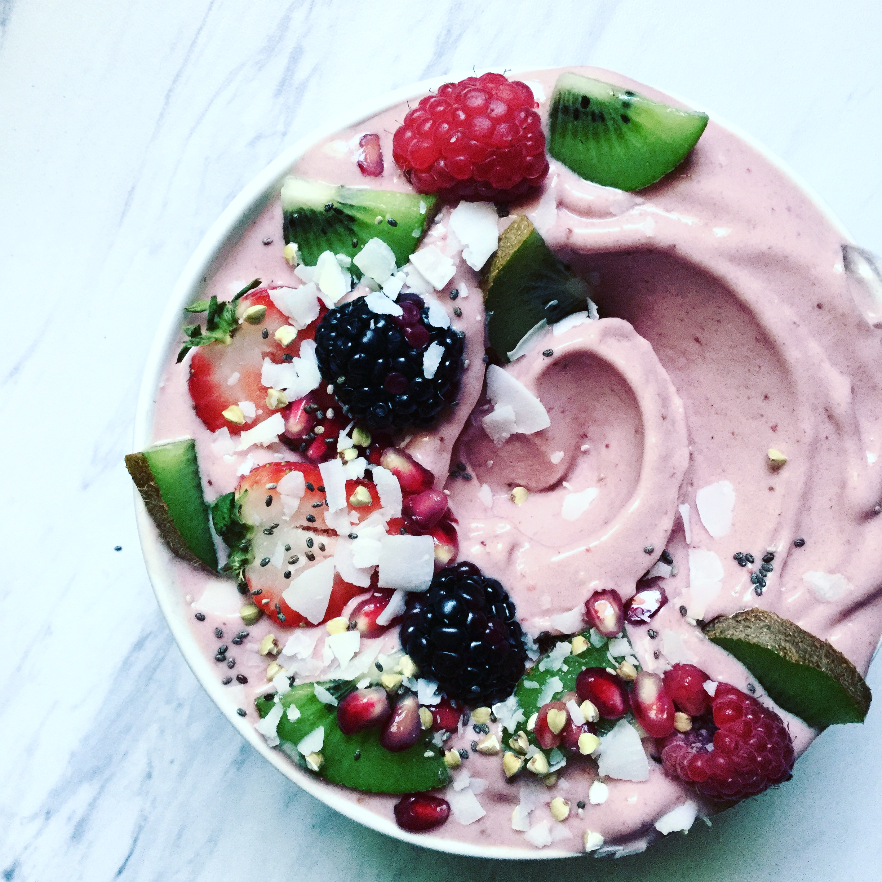
SAMPLE MENU
Breakfast bowl
Base:
□ Gluten-free Oatmeal
□ Banana Ice-cream
□ Acai
Toppings:
□Strawberries
□Blueberries
□Banana
□Seed Mix
□Chia Seeds
□Ground Flax
□Coconut Shavings
extras:
□Vanilla Plant Protein Powder
□Peanut Butter
□Almond Butter
□Sunflower Butter
Notes:
PRICE is 12-15$ range.

Slide 8
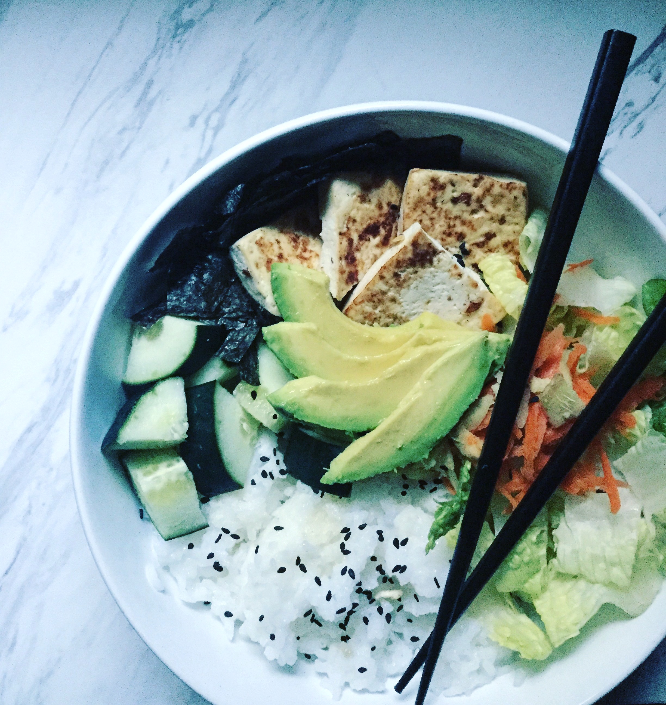
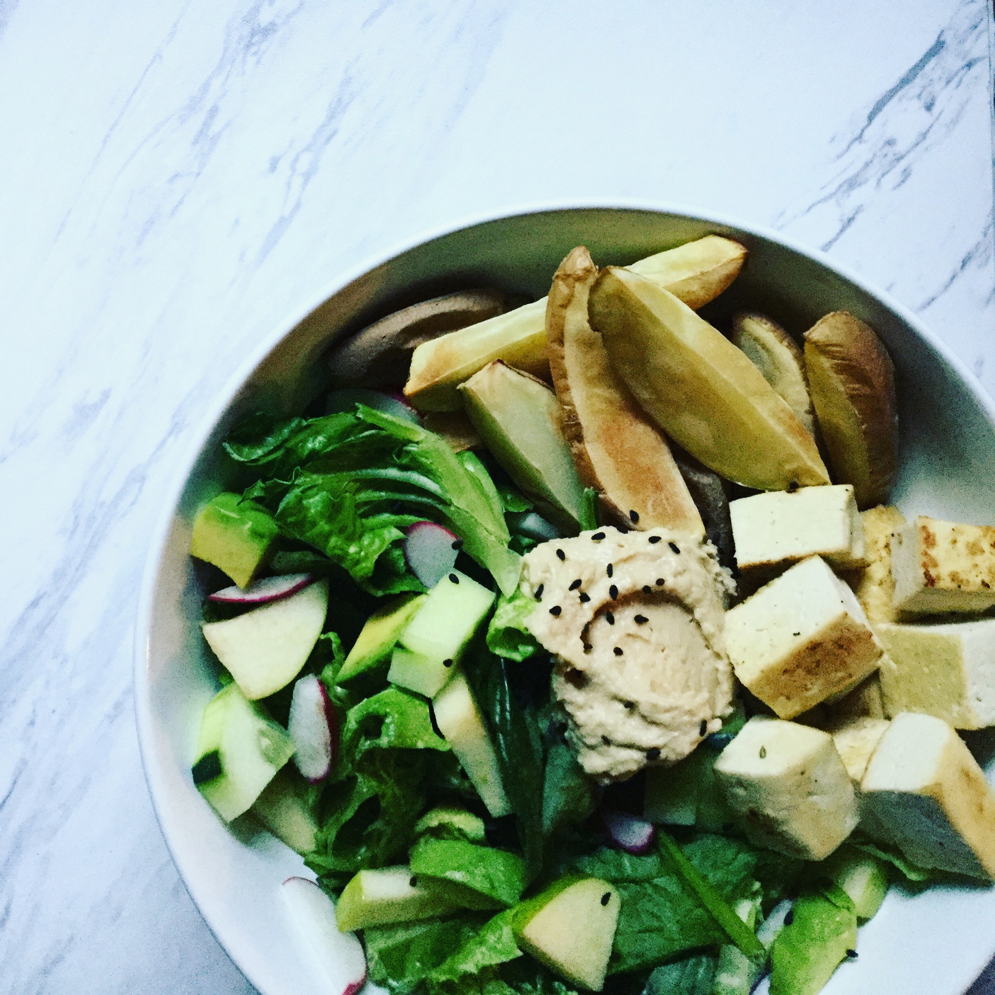
SAMPLE MENU
Lunch/dinner Bowl
Base:
□Mixed Greens
□Brown Rice
□Gluten-free
Whole-grain Pasta
□Roasted Sweet Potato Wedges
protein:
□Black Beans
□Roasted Chickpeas
□Sautéed tofu
vegetables:
□Steamed Cauliflower
□Roasted Carrots
□Raw Spiralized Zucchini
□Shredded Cabbage
Sauces:
□Thai Peanut Sauce
□Avocado Dressing
□Cashew Queso
□Salsa

Slide 9
TARGET POPULATION
“for all diets and lifestyles”
Including:
Those with Food intolerances (i.e. lactose intolerance)
Those with Food allergies (i.e. top 8 allergies…)
Those with alternative ways of eating (i.e. vegetarians, flexitarians…)

Slide 10
TARGET POPULATION/MARKET ANALYSIS
Among children aged 0–17 years, the prevalence of food allergies increased from 3.4% in 1997–1999 to 5.1% in 2009–2011 (Facts and Statistics, n.d.).
Top 8 Allergies Recognized by the United States Food and Drug Administration (FDA).
Milk
Eggs
Fish (e.g., bass, flounder, cod),
Crustacean shellfish (e.g., crab, lobster, shrimp),
Tree nuts (e.g., almonds, walnuts, pecans),
Peanuts
Wheat
Soybeans (“Consumers-Food Allergies, n.d.).

Slide 11
LOCATION
Over 2 million are working in San Francisco (Bureau of Labor Statistics Data, n.d.).
LOCATION: San Francisco, California

Slide 12
COMPETITORS
Chipotle- Healthier, provides build-your-own option, static menu
Jamba Juice- Healthy? fast options
General Fast Food- convenient, not healthy
HOW DO WE STAND OUT?
Static and Cyclic Menu- offer variety
Options for every diet
Fresh and Fast!

Slide 14
CONCLUSION
MISSION STATEMENT: To make fresh food fast, by providing individually prepared plant-based meals, based on wholesome and locally sourced ingredients, for all diets and lifestyles.
Staff Required – Require 4 Workers
Menu – Mixture of Static and Single Use
Target Population – all diets (especially those with TOP 8 allergies)
Location – San Francisco, Bay Area
Competitors – How do we stand out? More variety, fast, and healthy
Budget – Profit of about $70,000 in first year

Slide 15
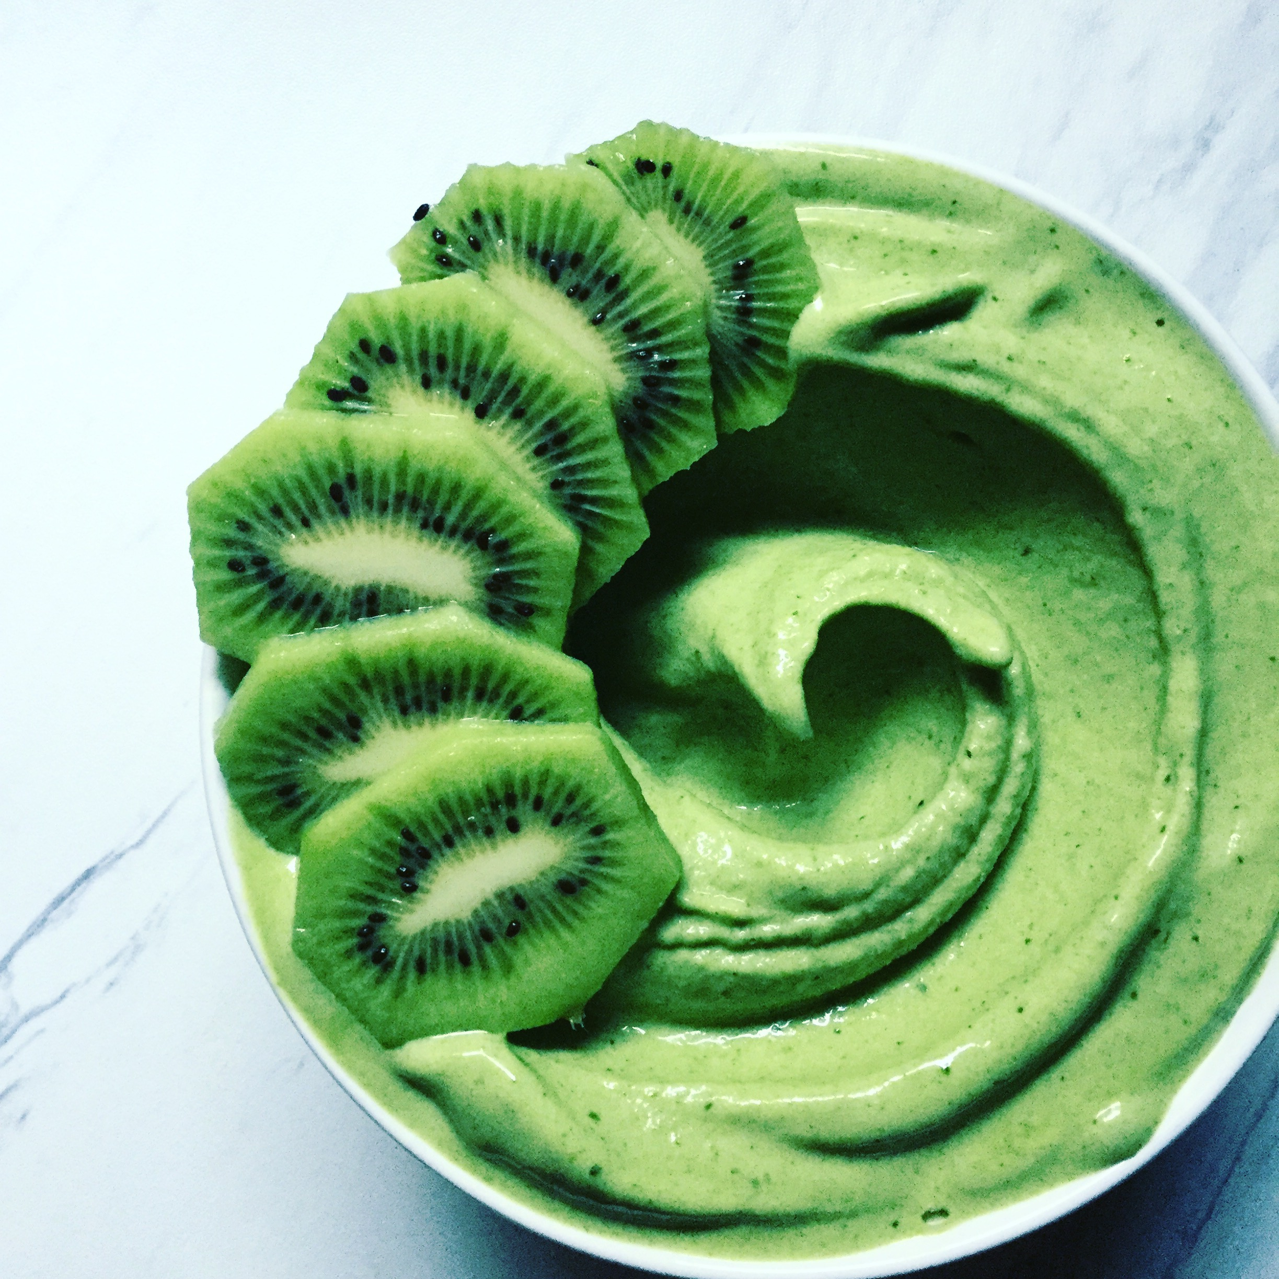
Thank You

Slide 16
References
1. Center for Food Safety and Applied Nutrition. (n.d.). Consumers - Food Allergies: What You Need to Know. Retrieved November 02, 2017, from https://www.fda.gov/food/resourcesforyou/consumers/ucm079311.htm
2. Facts and Statistics. (n.d.). Retrieved November 02, 2017, from https://www.foodallergy.org/life-food-allergies/food-allergy-101/facts-and-statistics
3. Hudson, N. R. (2013). Management practice in dietetics. San Diego, CA.: Cognella.
4. National Center for Health Statistics. (2013, May 02). Retrieved October 31, 2017, from https://www.cdc.gov/nchs/products/databriefs/db121.htm
5. ServSafe Allergens. (n.d.). Retrieved December 02, 2017, from https://www.servsafe.com/ServSafe-Allergens.

